Slide 1
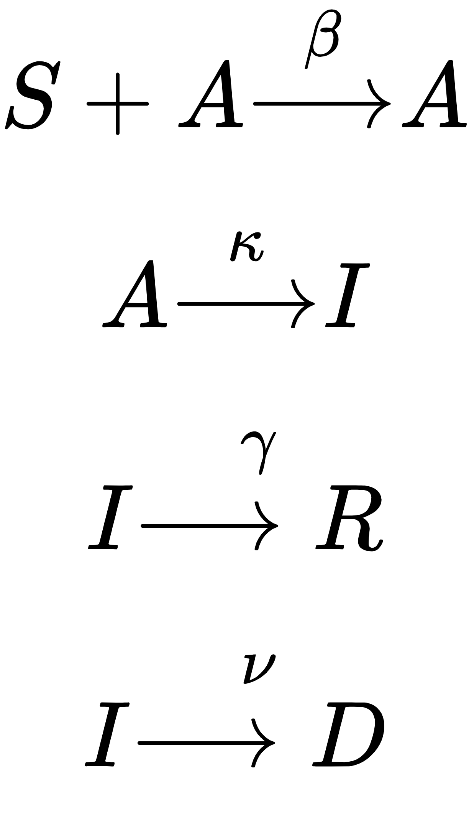
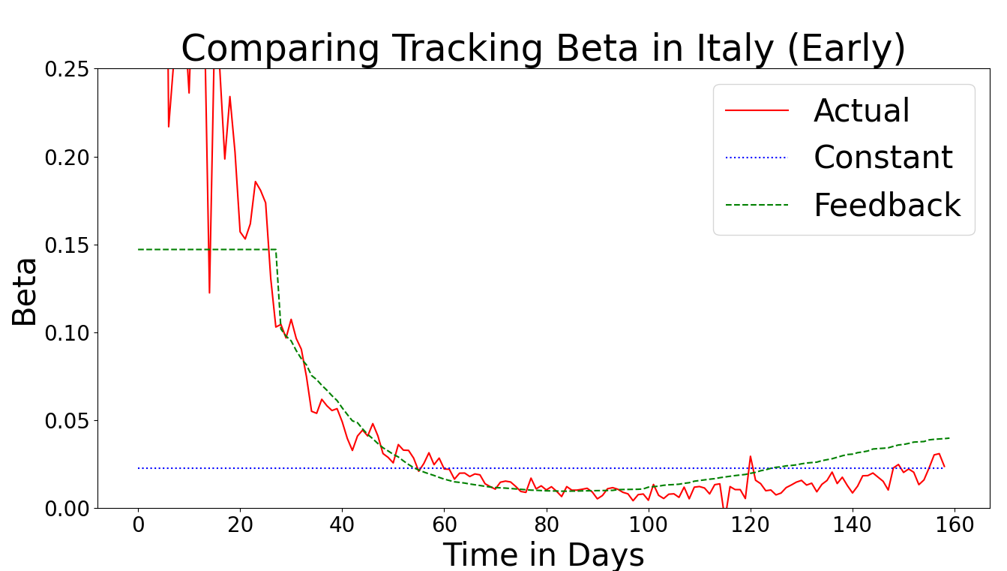
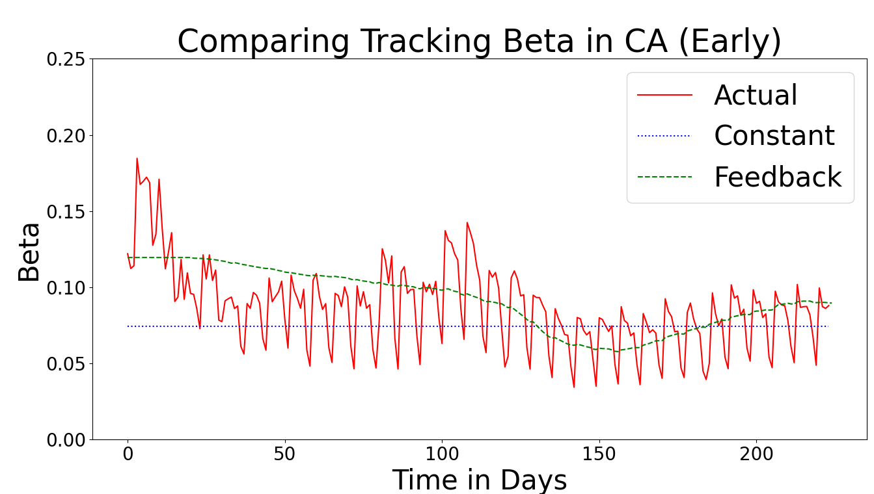
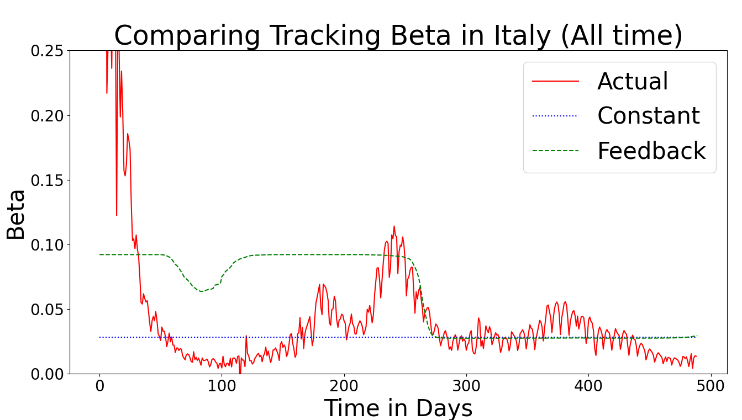
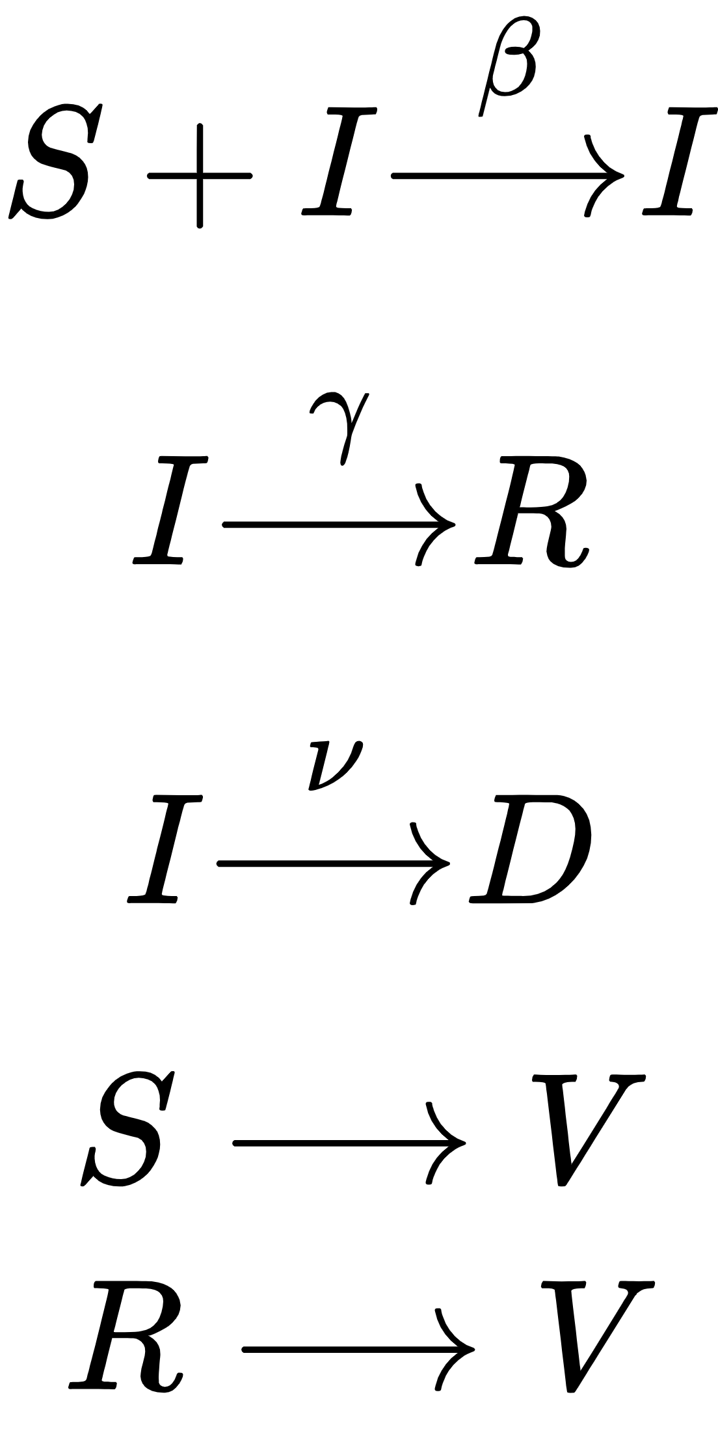
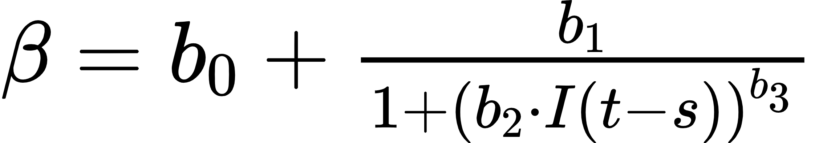
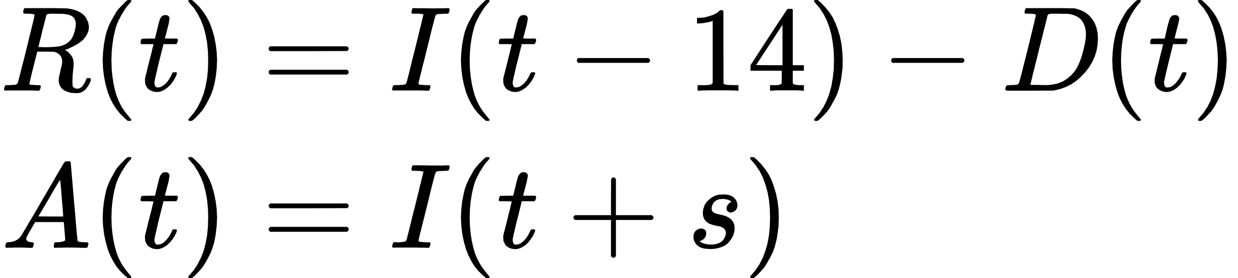
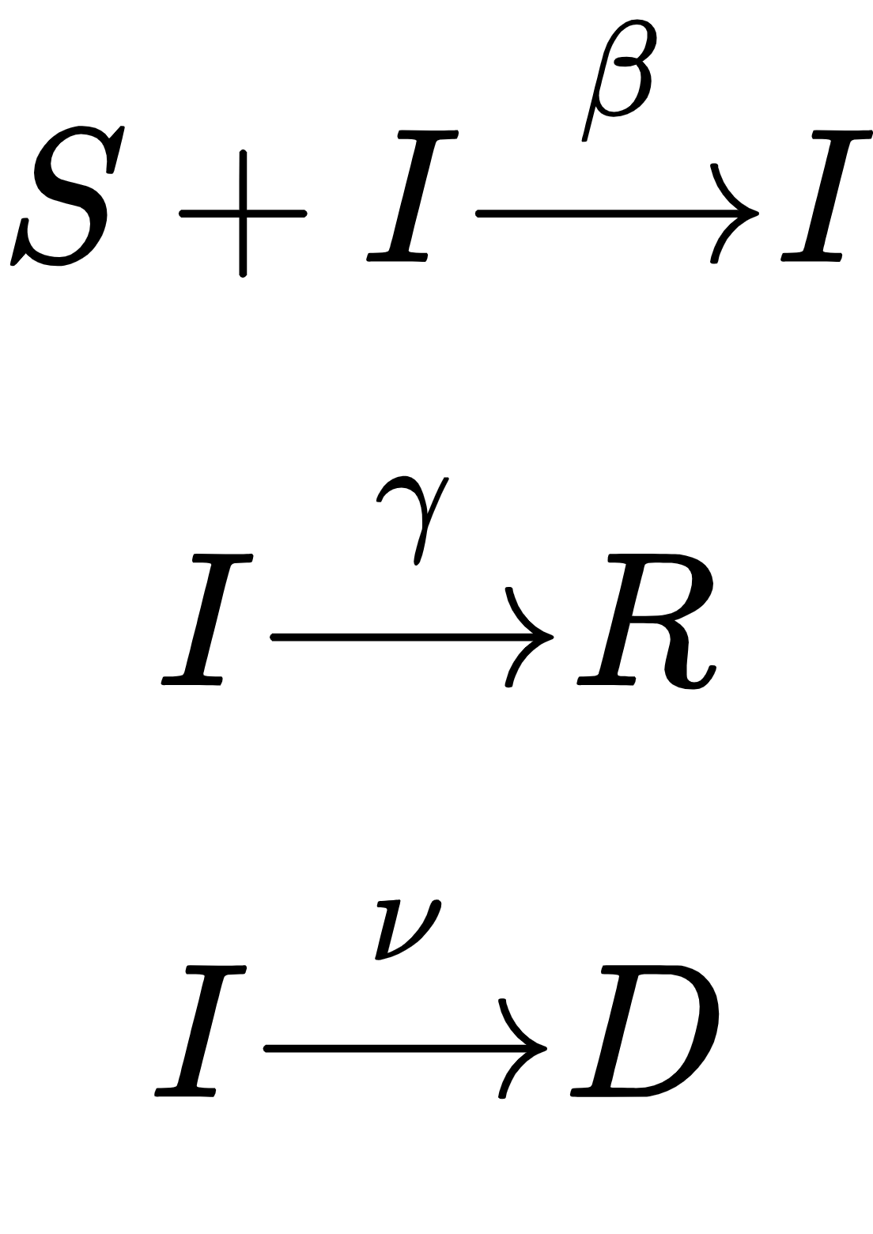
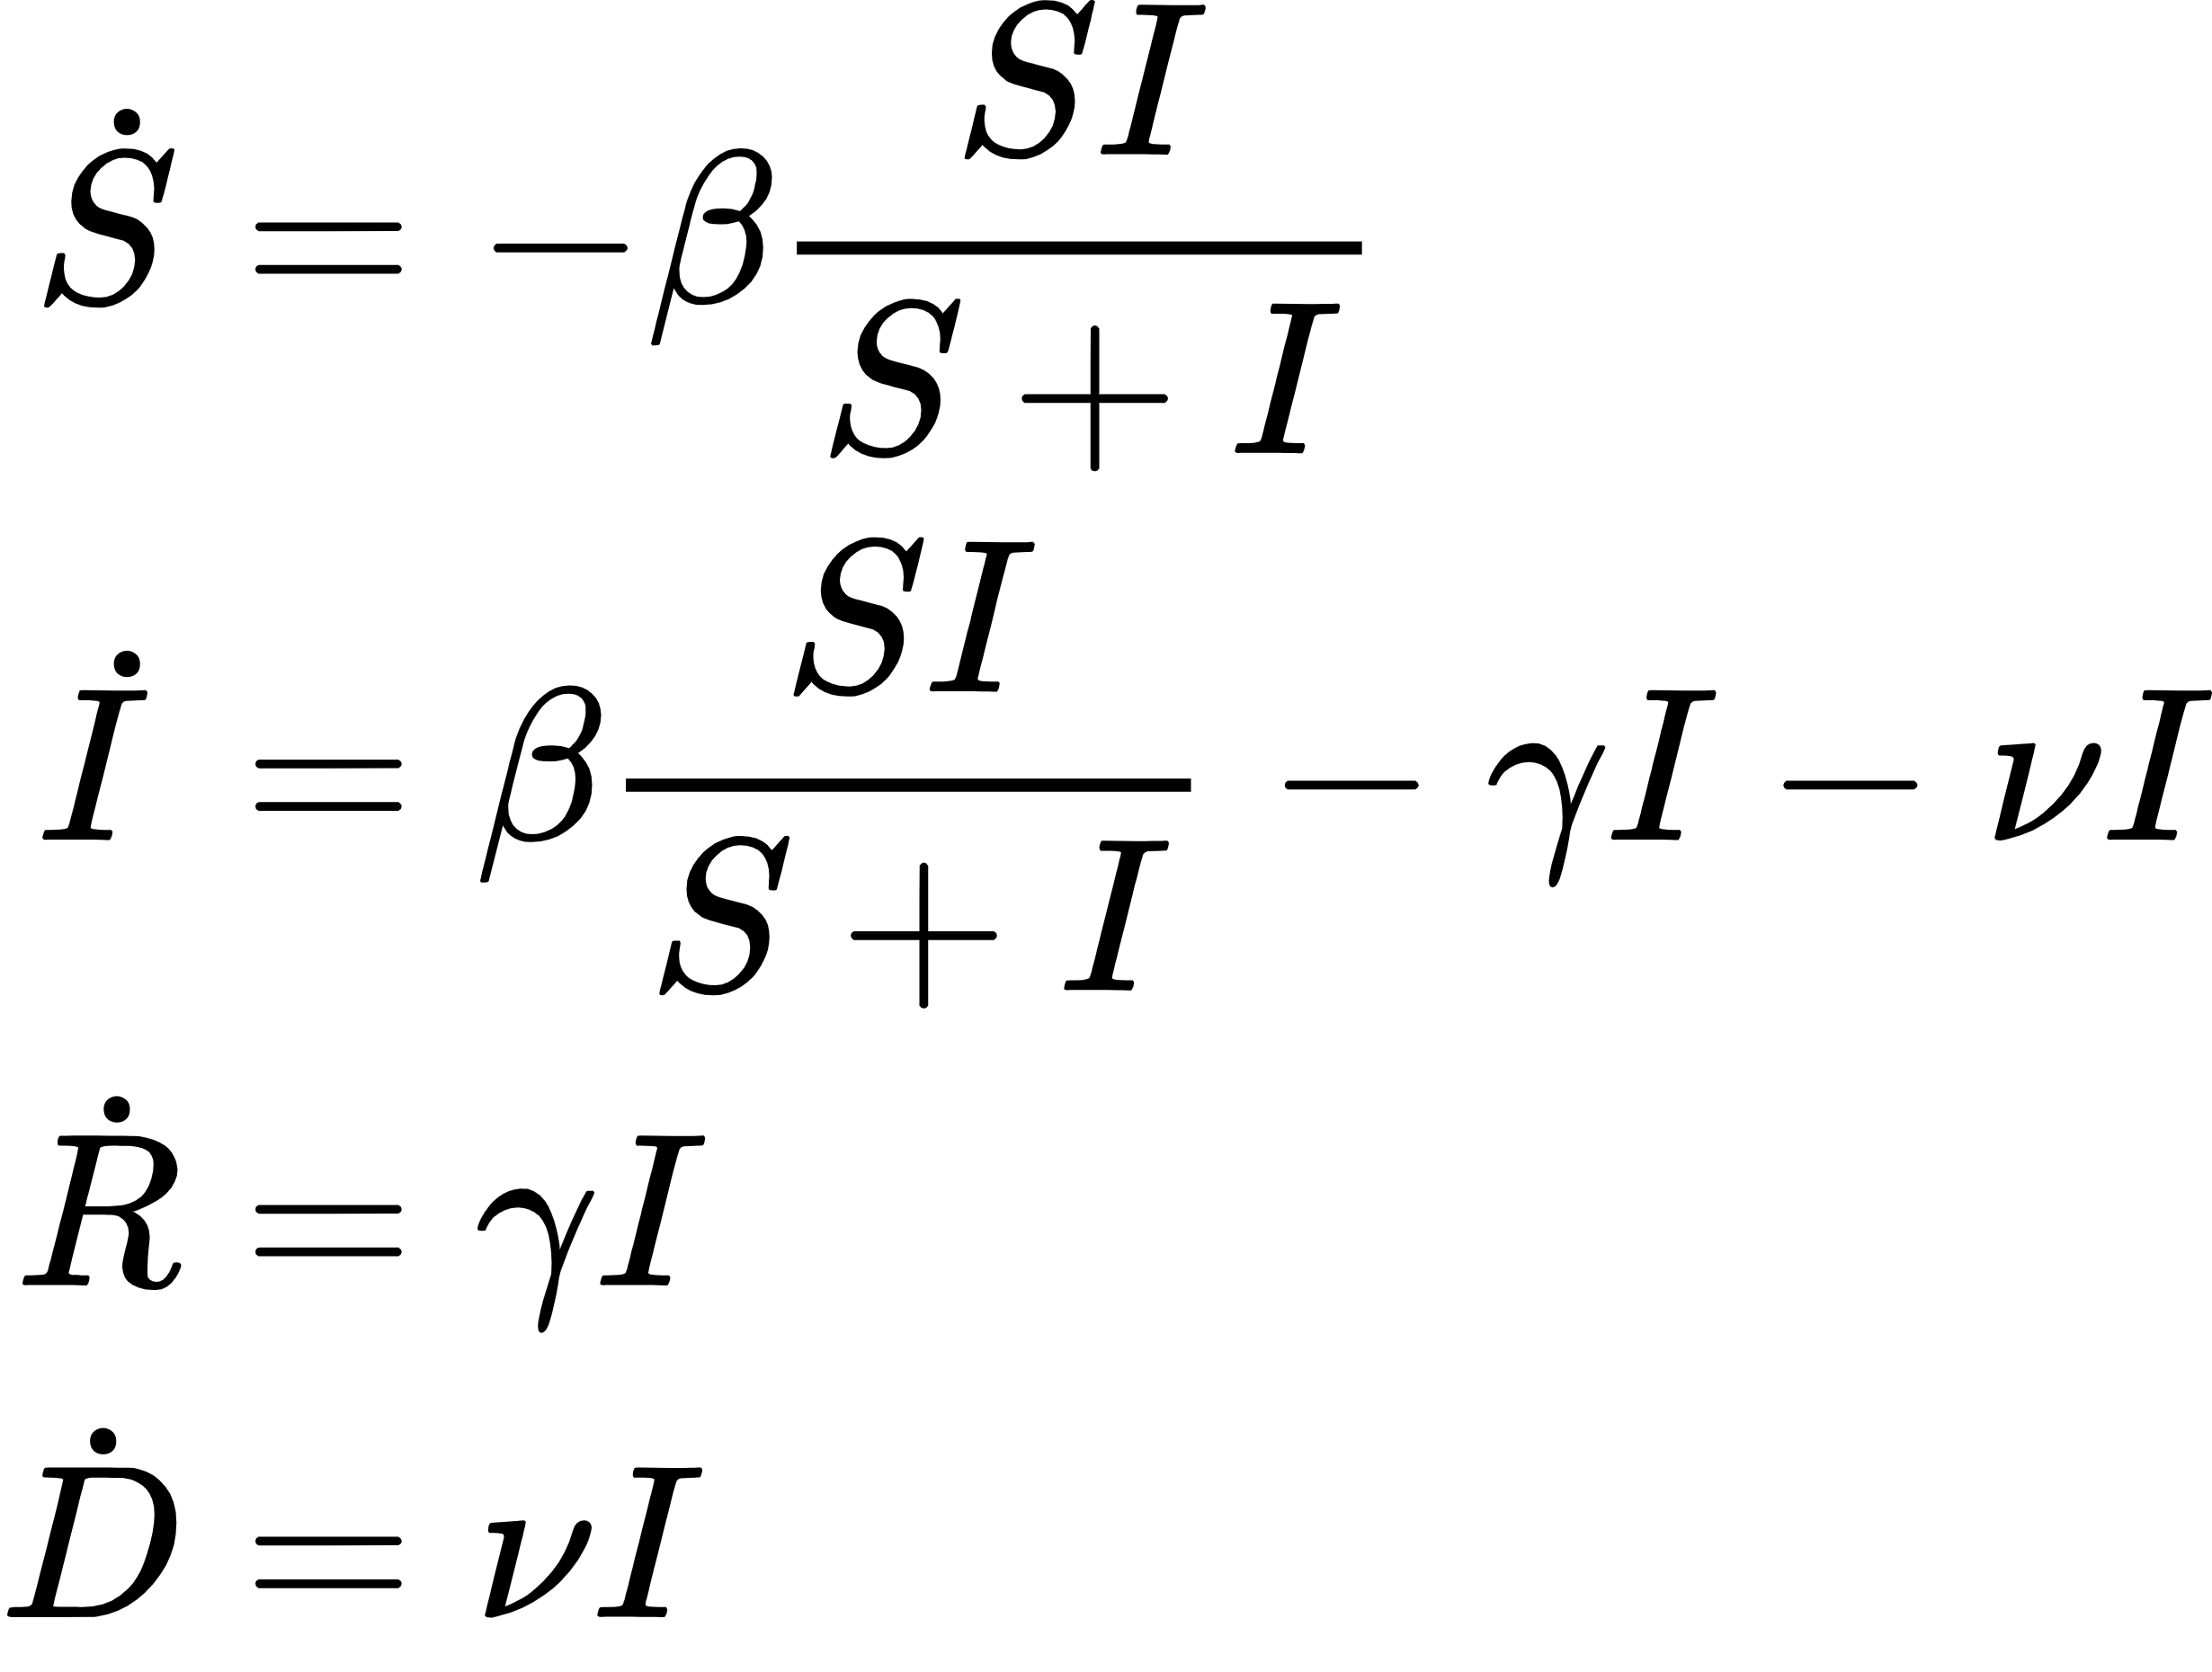
Using Feedback and Vaccination Data to More Accurately Model and Predict the SARS-CoV-2 Pandemic Daniel March, Jeston Bond, Gentian Buzi Department of Math and Computer Science, Biola University
Abstract
We compare the predictive power of several different disease models and their ability to model the transmission, recovery and death rates. The simplest disease model tracks the susceptible, infected, recovered, and dead populations over time (SIRD). We additionally use a model incorporating asymptomatic individuals (SAIRD) and add a degree of feedback to these models to better track the transmission rate. The inclusion of feedback enables the model to predict minor outbreak spikes, which is a major advantage over the basic SIRD model.
SAIRD:
The SAIRD model is similar to the SIRD model but introduces an asymptomatic population (see methods/approach for asymptomatic approximation). The population interactions can be seen on the right.
SIRD+V:
The SIRD+V model introduces a vaccinated population group. This model assumes that susceptible and recovered individuals will exit at the same rate into the vaccination rate.
Feedback SIRD:
This model is identical to the SIRD model except for the transmission rate parameter, β. Beta is replaced with a time varying function depending on the current infections with a delay, s (typically s=14). The nature of β is that in times of high infections, the transmission rate will decrease after some delay and then rise back again when infections have decreased.
Feedback SAIRD:
The SAIRD feedback introduces the same model additions to the SAIRD model as the SIRD feedback does to the SIRD model, with the exception that the delay is modeled inherently by the asymptomatic to infected interaction.
Results
Modeling Transmission Rate in Italy and California: (graph over time, constant, and feedback)
Predicting first wave decline: (all models should do moderately well here)
Predicting first wave: (sird should spike wildly, feedback should model somewhat well)
Predicting late-stage wave: (sird should spike, feedback should model somewhat well)
Data
The data for this project was extracted from publicly available databases. For US data, numbers for daily total infections, deaths, and vaccinations was acquired from the CDC. For Italian data, numbers for current infections, recoveries, and death were acquired from the Italian Department of Civil Protection.
Methods/Approach
Due to the nature of the data, not all infections, recoveries, and deaths are recorded. Therefore, a scaling factor to I, R, D must be used to properly model these populations. This value, q, is solved by gridding values and minimizing an objective function
Some additional populations must be approximated since these values aren’t always reported. The recovered and asymptomatic populations can be approximated using the below equations. Note that S,A,I,R,D are time series.
Conclusion
References
Models
SIRD:
The SIRD model is among the simplest of disease models. The model interactions can be seen to the right and the exact equations for the daily change in each population below this. The transmission rate, recovery rate, and death rate can be solved for using least squares regression and are approximated as constants.

